Slide 1
Keyword Extraction
Prudhvi Raj Dachapally

Slide 2
Goal
Making sure that important words etch into the minds of school children.

Slide 3
Sample Text (No Keywords)
Smoking is very injurious to health. It is harmful both to a smoker and his companion. It affects lungs and causes serious diseases. One of the chief causes of ailment is smoking. It pollutes the environment too. Government should take steps to fine the people smoking at public places.

Slide 4
Sample Text (With Keywords)
Smoking is very injurious to health. It is harmful both to a smoker and his companion. It affects lungs and causes serious diseases. One of the chief causes of ailment is smoking. It pollutes the environment too. Government should take steps to fine the people smoking at public places.

Slide 5
Methods
PCA
Clustering + PCA

Slide 6
PCA
Intuition
If we pose the problem of keyword detection as a dimensionality reduction problem, we will be able to get the keywords (important words) as our principal components.
Algorithm
First we have to convert our words into some distributional representational space (word2vec or GloVe). We used word2vec.

Slide 7
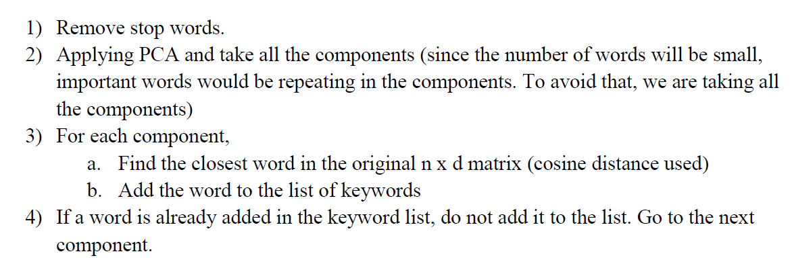
Keyword Extraction with PCA

Slide 8
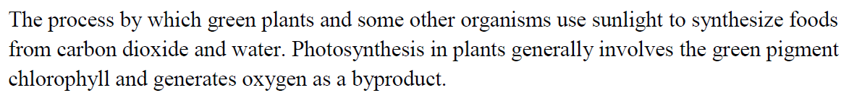
Example

Slide 9
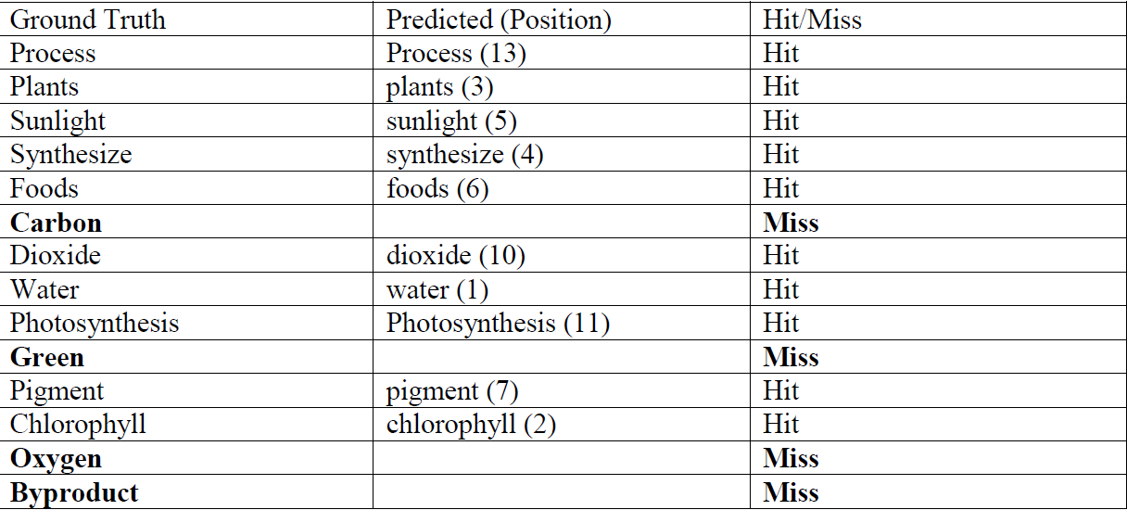
Results

Slide 10
Clustering + PCA
Assumption
Since we are working with short text sentence in the educational domain, most of the time the entire document belongs to one “topic”.
Intuition
If we cluster the document into two clusters, one cluster will store all the words related to the topic, while the other has all the remaining words.
Then if we apply PCA on the topic-related cluster, we will be able to get good quality keywords.

Slide 11
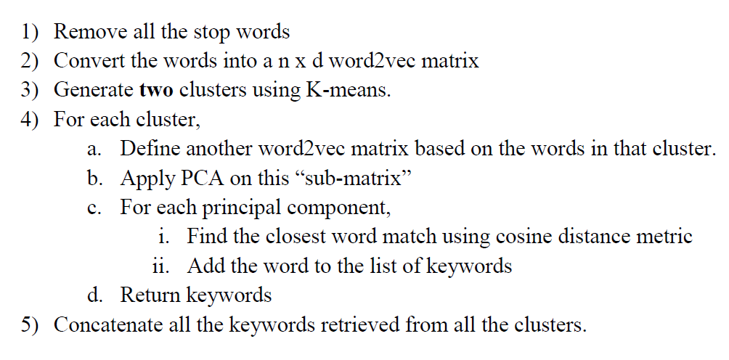
Algorithm

Slide 12
Scoring Metric
Since we are working on a unsupervised domain, to check the quality of the results, we need a manual evaluation. For that purpose, we defined a new scoring metric.
Red– Miss/Wrong
Green – Hit
Blue – Maybe Hit
Dark Blue – Maybe Miss
Score = (Hit – Miss/Wrong + (0.5 * Maybe Hit) – (0.25 * Maybe Miss)) / Total Predictions

Slide 13
Example: Clustering + PCA Score = 12 – 2 + (0.5 * 2) – (0.25 * 3) / 14 = 10.25/14 = 0.732
The Solar System consists of the Sun Moon and Planets. It also consists of comets, meteoroids and asteroids. The Sun is the largest member of the Solar System. In order of distance from the Sun, the planets are Mercury, Venus, Earth, Mars, Jupiter, Saturn, Uranus, Neptune and Pluto; the dwarf planet. The Sun is at the center of the Solar System and the planets, asteroids, comets and meteoroids revolve around it.

Slide 14
Example (Clustering + PCA) Score : 15 – 2 + (0.5 * 4) – (0.25 * 3) / 22 = 14.25/ 22 = 0.6477
The sun is a huge ball of gases. It has a diameter of 1,392,000 km. It is so huge that it can hold millions of planets inside it. The Sun is mainly made up of hydrogen and helium gas. The surface of the Sun is known as the photosphere. The photosphere is surrounded by a thin layer of gas known as the chromospheres. Without the Sun, there would be no life on Earth. There would be no plants, no animals and no human beings. As, all the living things on Earth get their energy from the Sun for their survival.

Slide 15
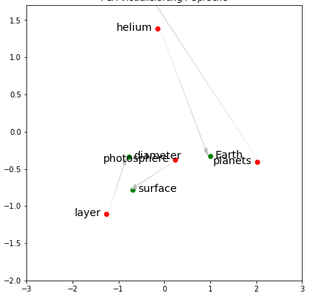
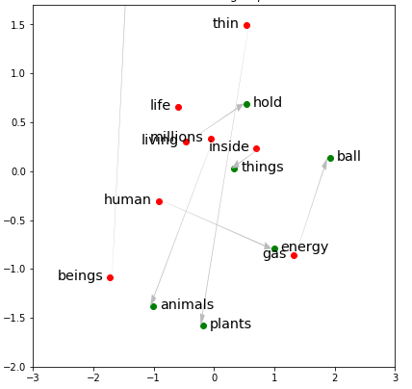
Word Clusters

Slide 16
Future Work
Primary
Manual clustering using cosine as the distance metric
Improving the score metric
Collecting more data
Secondary
Self – Organizing Maps
Autoencoders

